Slide 1

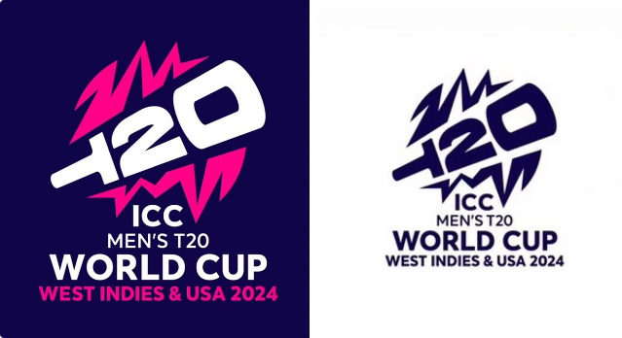

2024 ICC Men's T20 World Cup: A Comprehensive Analysis
The 2024 ICC Men's T20 World Cup, co-hosted by the West Indies and the United States, provided a thrilling spectacle of cricket. The tournament, featuring an expanded field of 20 teams, saw India emerge victorious, securing their second T20 World Cup title.

Slide 2

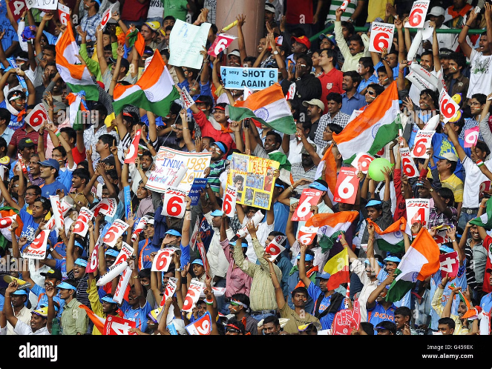
Tournament Overview
1
Co-Hosts
The tournament was co-hosted by the West Indies and the United States, bringing the excitement of cricket to new audiences.
2
Expanded Field
An expanded field of 20 teams, including first-time participants Canada, Uganda, and the United States, added to the tournament's diversity and competitiveness.
3
Indian Victory
India, led by the experienced Rohit Sharma, emerged victorious, defeating South Africa in a thrilling final by 7 runs.
4
Second Title
This victory marked India's second T20 World Cup title, placing them alongside England and West Indies with two championships each.

Slide 3

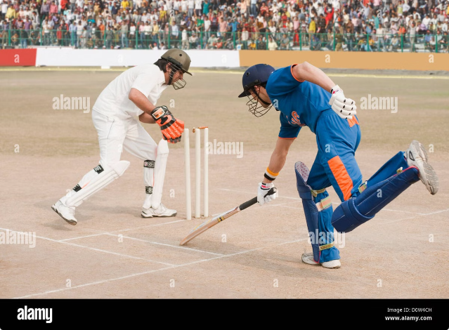
Batting Performances
Player
Runs
Highest Score
Strike Rate
Sixes
Rahmanullah Gurbaz
281
98
145.36
16
Rohit Sharma
257
87
138.78
15
Travis Head
255
89
134.87
12

Slide 4
Bowling Performances
Economy Rate
Other Top Performers
Jasprit Bumrah exhibited remarkable control, leading the bowlers with an economy rate of 4.63 in over 150 balls bowled.
Mustafizur Rahman and A. Nortje followed closely behind Bumrah in terms of economy rate, showcasing their bowling prowess.

Slide 5


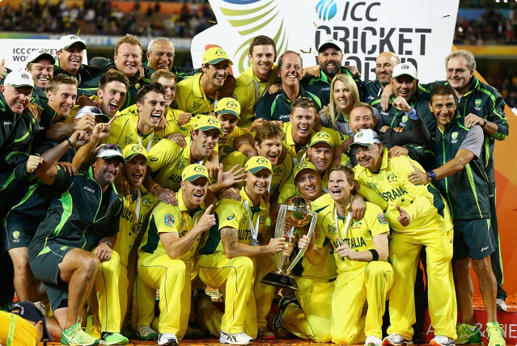

Team Performances
Winning the Toss
Choosing to field after winning the toss provided a slight advantage, with teams fielding first having a higher win percentage.
Chasing Targets
Teams chasing targets also displayed a slightly higher success rate compared to those setting targets, indicating the benefits of batting second.

Slide 6




Venue Analysis
Winning Venue
Venue Impact
The analysis revealed a specific venue as the most common for winning matches, though the exact venue name was not provided in the summary.
The venue's characteristics, including pitch conditions and crowd support, likely played a significant role in team performances.

Slide 7

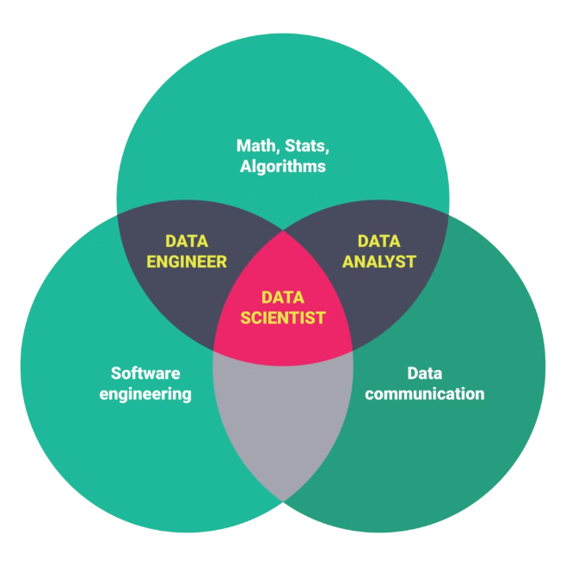
Machine Learning Models
1
Model Training
Various machine learning models, including Logistic Regression, Decision Trees, Random Forests, Extra Trees, and AdaBoost, were trained to predict player dismissals.
2
AdaBoost Classifier
The AdaBoost Classifier demonstrated promising performance, though specific performance metrics were provided in the summary.
3
Model Evaluation
The models' accuracy and predictive power were evaluated using appropriate metrics, providing valuable insights into player dismissals.

Slide 8

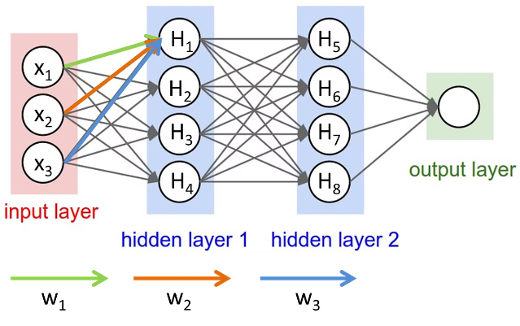
Deep Learning
CNN Application
A Convolutional Neural Network (CNN) was implemented for image classification, likely for classifying images related to the tournament, such as logos, players, and venues.
Accuracy
The CNN model achieved a certain level of accuracy, though the exact figure was specified in the summary.

Slide 9
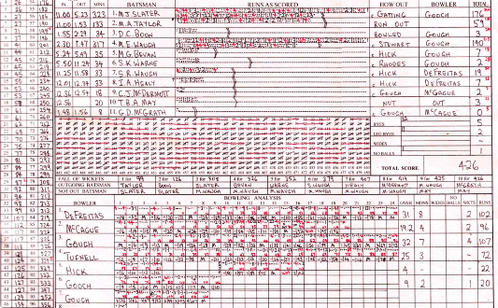
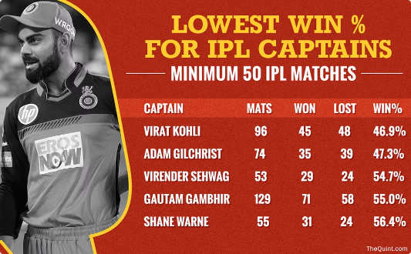
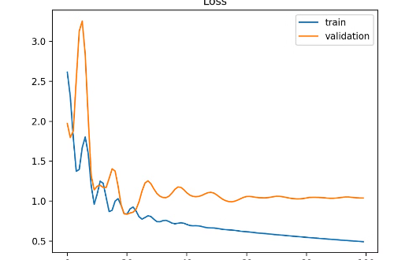
Data Visualization
Batting and Bowling Performances
Team Win Percentages
Model Performance Metrics
Data visualizations provided a clear and concise representation of team win percentages, allowing for easy comparison and analysis.
Visualizations effectively presented model performance metrics, such as accuracy, precision, and recall, providing a clear understanding of the models' effectiveness.
Visualizations effectively illustrated individual and team performances, highlighting key statistics such as runs scored, wickets taken, and strike rates.

